Slide 1
Data Analysis Using Spark SQL
By
Vuthur Sriganga

Slide 2
Agenda
Project Statement
Overview
Process Flow
Azure Resources/Tools used
Project Requirements
Implementation
Conclusion

Slide 3
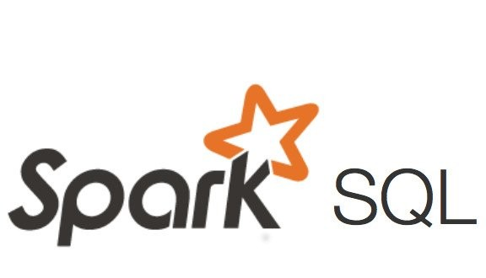
Project Statement
Implement Data analysis using Spark SQL on Azure Databricks & Process data for errors, Seasonality, and Anomalies.

Slide 4
Overview
The main aim of this project is to demonstrate how data analysis can be performed using SparkSql and how we can process data for errors, anomalies and seasonalities in Azure DataBricks.
In this the key points would be:
Data Analysis with Spark SQL
Error Processing
Anomaly Detection
Seasonality Analysis

Slide 5
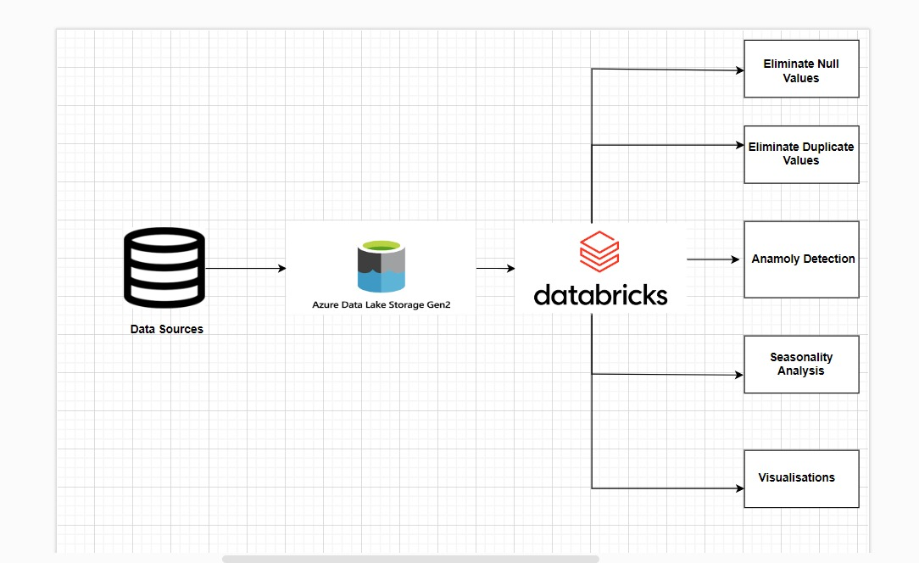
Process Flow
Setting up Azure DataBricks Workspace
Connecting Data Source to Azure DataBricks
Running SparkSQL queries for:
Data Analysis
Error Handling
Anomaly Detection
Seasonality Analysis

Slide 6
Azure Resources/Tools used
Azure Data Lake Storage Gen2:Here the raw data is uploaded in CSV format.
Azure Databricks: It is used for Data Transformations.We run various SparkSQL commands to do Data cleaning and Transformations.
SparkSQL: SparkSQL is a component of Apache Spark that provides a programming interface for structured and semi-structured data
Azure Portal:
It would be used for provisioning and configuring resources such as Azure Data Lake Storage Gen2, Azure Data Factory, and Azure Databricks.
Microsoft Excel :
Microsoft Excel might be used for data preparation or as a data source for creating input datasets for project.

Slide 7
Project Requirements
Data Ingestion
Data Exploration
Data Cleaning
Data Analysis with Spark SQL
Error Detection
Seasonality Analysis
Anomaly Detection
Visualization

Slide 8
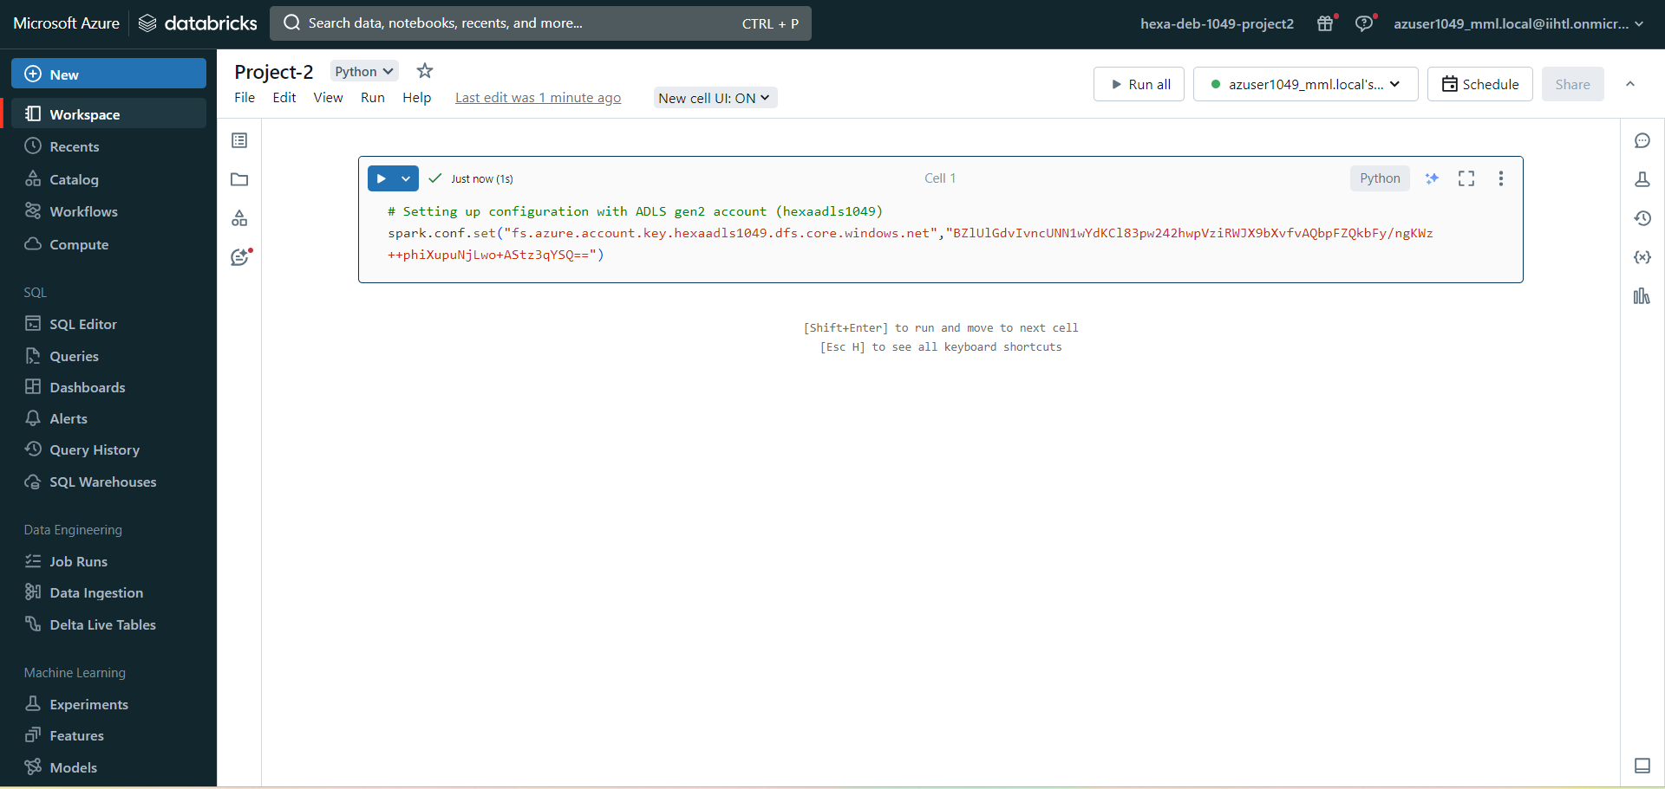
Implementation-Setting Up Azure DataBricks
In the Azure Portal create a new databricks workspace .
Once, it is successfully deployed , Launch the DataBricks workspace.
Create a new cluster in it and set up the parameters as required.
Create a notebook connected to the cluster to perform transformations.

Slide 9
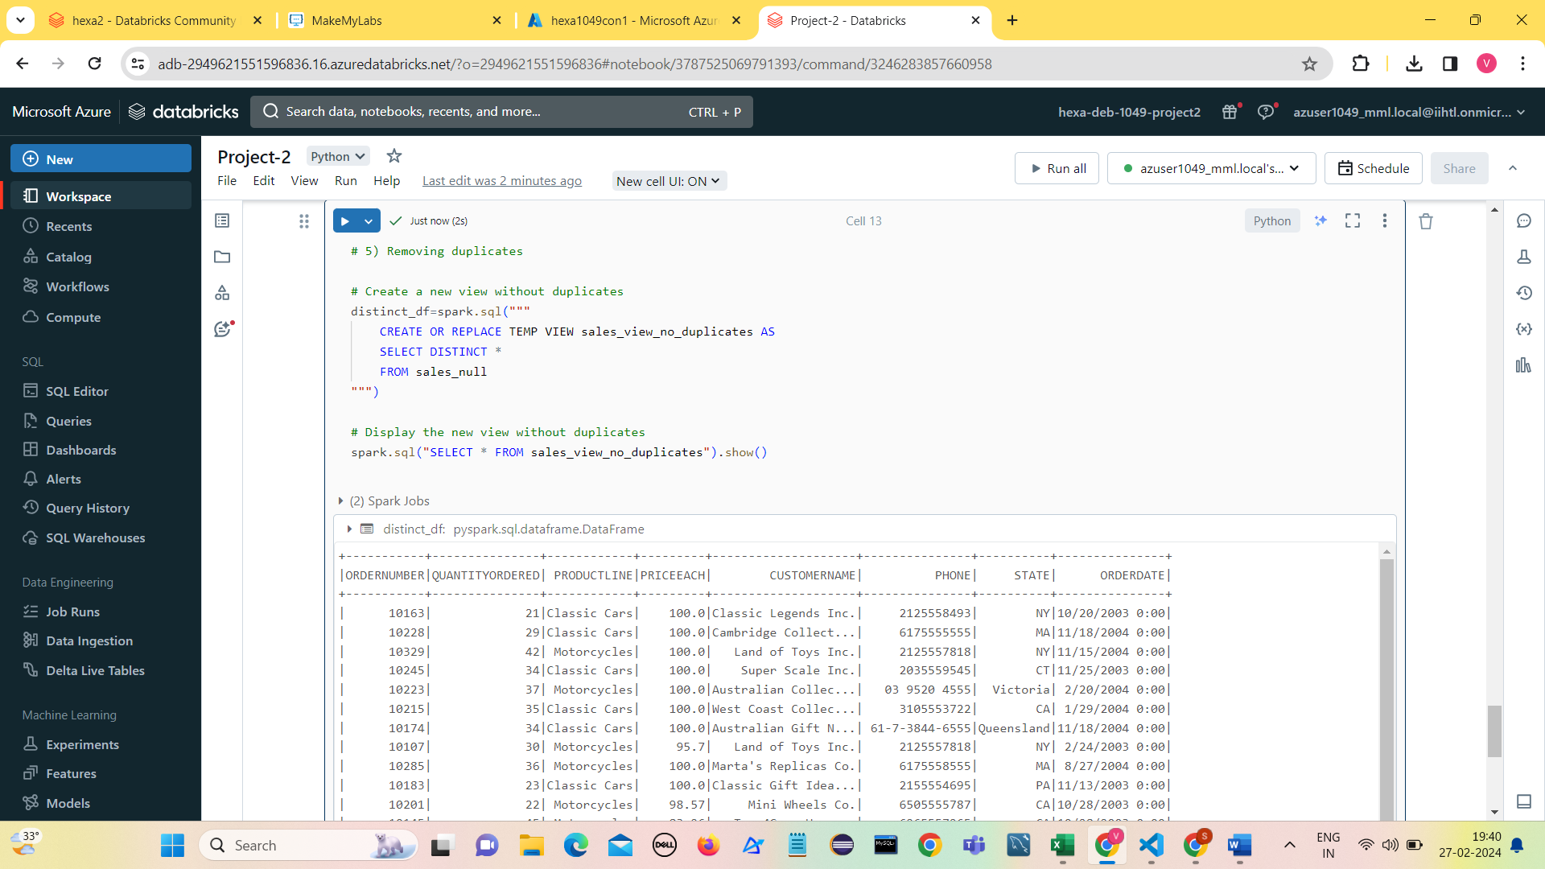
Error Handling
Perform Error Handling with SparkSql Queries to remove duplicate values from the dataset.

Slide 10
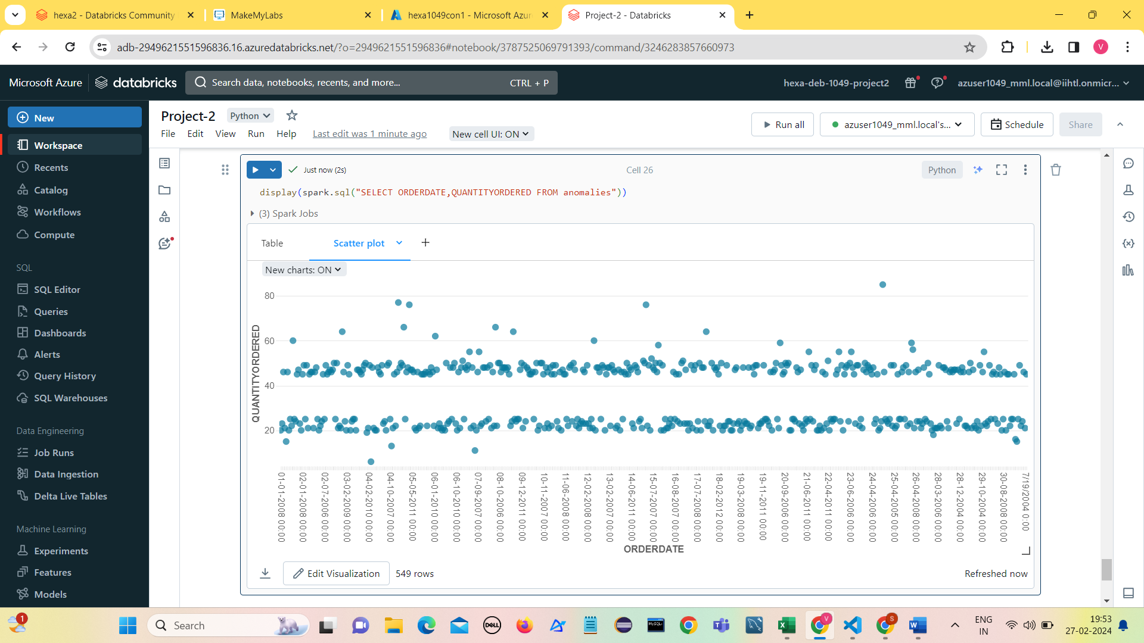
Anomaly Detection
Perform Anomaly Detection in dataset through SparkSQL queries by calculating z-score.
Steps:
Calculate Z-scores for each value
Define anomaly threshold (e.g., Z-score greater than 1)
Analyze the identified anomalies.
Visualization of Anomalies (e.g., scatter plot of ORDERDATE vs. QUANTITYORDERED)

Slide 11
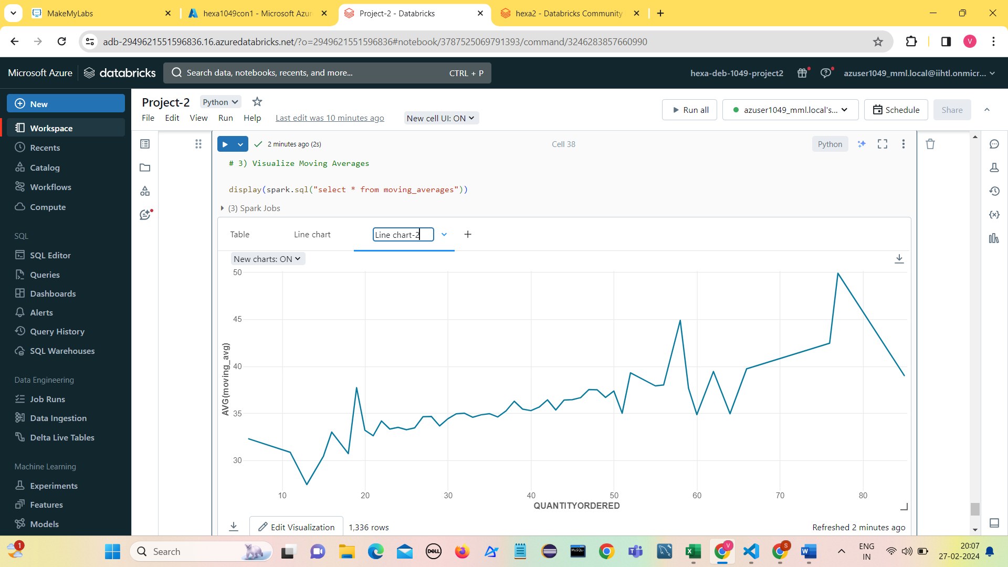
Seasonality Analysis
Analyze the data for seasonality patterns using Spark SQL.
Apply time series analysis techniques such as moving averages to identify recurring fluctuations over time.
Steps:
Apply moving average to smooth out seasonal variations.
Analyze Moving Averages.
Visualize Moving Averages in Azure Data Bricks.

Slide 12
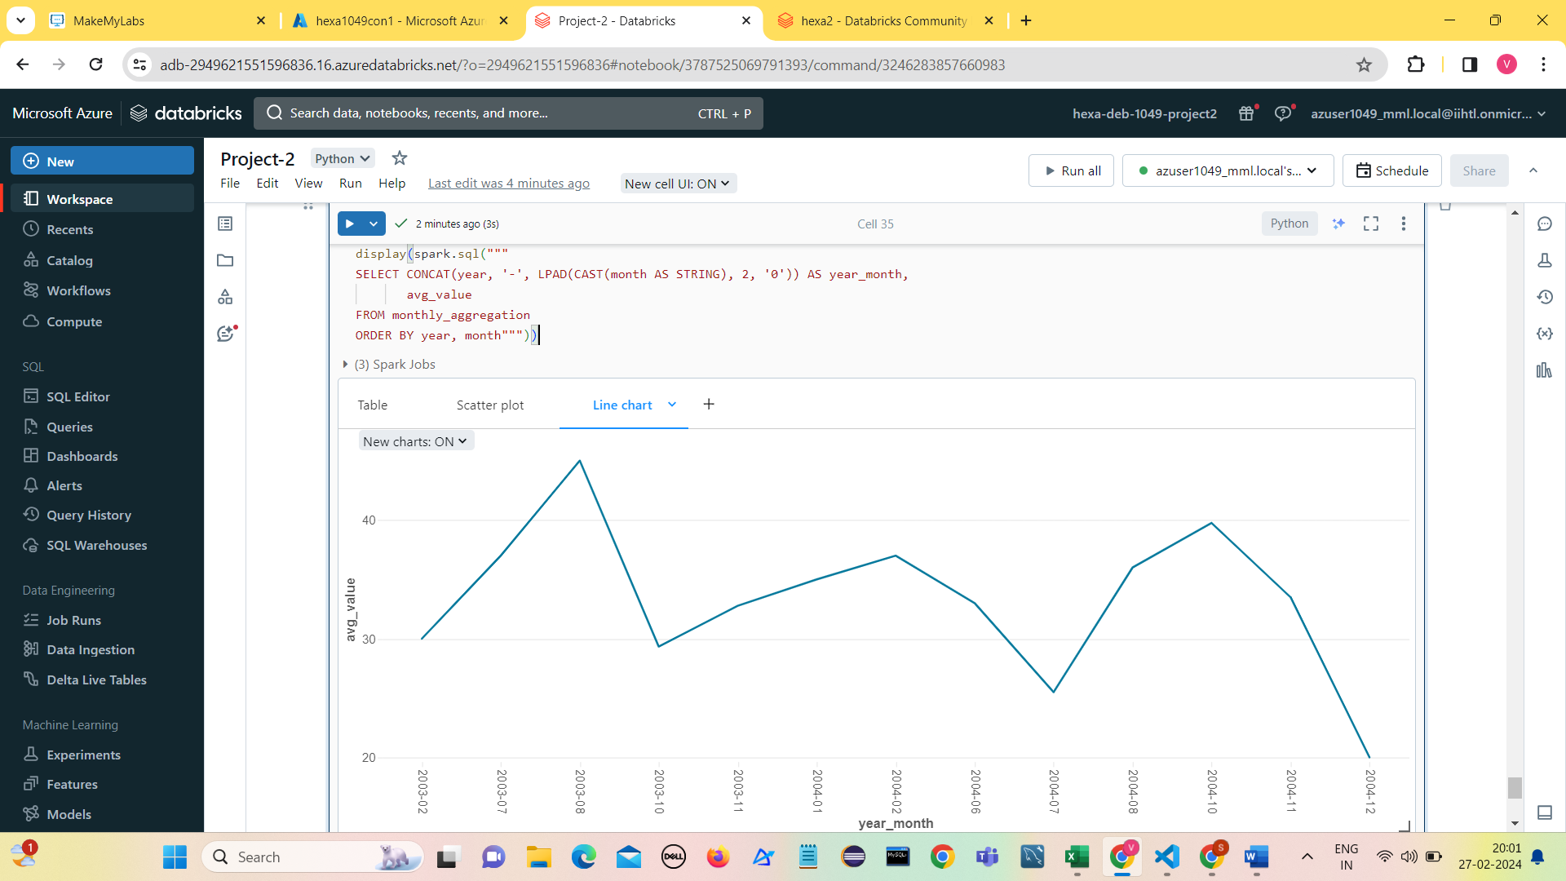
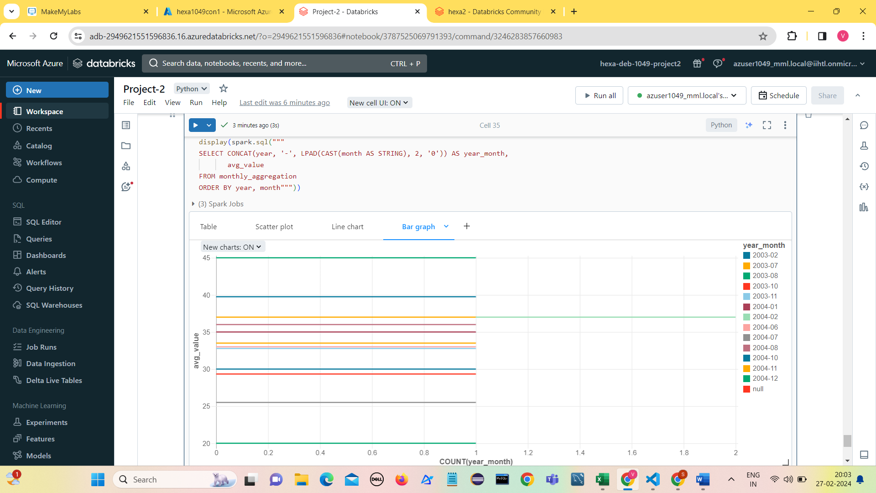
Visualizations
Add some visualizations to have a clear insight of our dataset.

Slide 13
Conclusion
Implementing data analysis with Spark SQL on Azure Databricks enables a seamless and efficient approach to processing and understanding large datasets.
Addressing errors ensures the reliability of insights, while seasonality analysis and anomaly detection contribute to a deeper understanding of data patterns.
This approach provides a comprehensive solution for uncovering insights, improving data quality, and gaining valuable knowledge from the analyzed dataset.
The insights gained from this project can inform strategic decision-making and operational planning for various domains, including retail, finance, healthcare, and more.

Slide 14
THANK YOU

